Slide 1

Hazard pointers
Daniel Pagan

Slide 2
Problem
Locks are problematic
Deadlock
Ordering
Long critical sections
Granularization doesn’t help if all the locks read from the same location
What happens when a thread dies with ownership of a lock?

Slide 3
Hazard Pointers
Lock-free
Wait-free
Compare and Set
ABA Problem

Slide 4
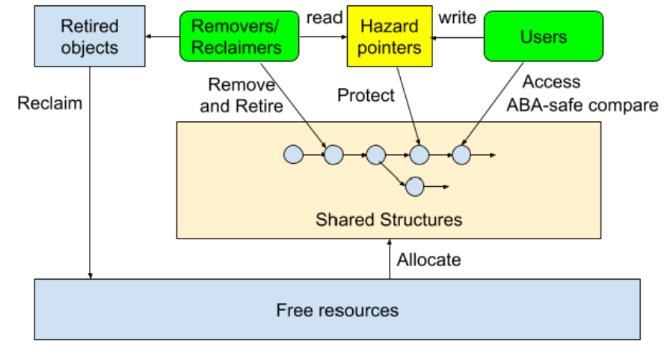
Hazard Pointers

Slide 5

Hazard Pointers

Slide 6
Approach
TLA+ with PlusCal
Time based sequence to track writes
Mimic pointers
Direct temporal logic not needed with TLC assert
Await as a primitive means we are wait free

Slide 7
Findings
Model works!
Best case is covered
Modeling thread failures?
Penalty function for failed readers
Scalability issues for HashMaps

Slide 8
Lessons Learned
Scaling issue
Lack of visualization in TLA+
Complexity of translated local state from PlusCal
Modularization unclear across processes

Slide 9
Future Work
Changing hazard pointers to front load computation to readers (read rare, write many)
Discovering ways to limit complex data structure space
Model memory without state space explosion
Quantify thread failure and determine a penalty function

